Slide 1
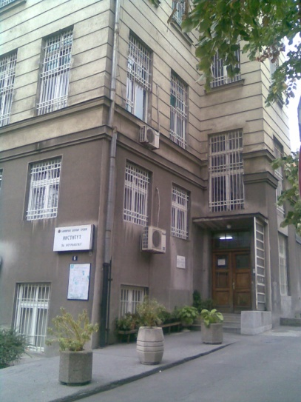
Transcranial detection of microemboli signals (MES) in patients with antiphospholipid syndrome and stroke
Zagorka Jovanović
Emina Jaganjac
Predrag Miljić
Milija Mijajlović
Tamara Švabić
Bosiljka Vujisić Tešić
Edita Cvitan
Dušan Damjanović
Marko Savić

Slide 2
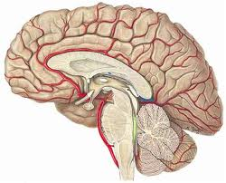
Introduction
After systemic venous thrombosis, stroke and transient ischemic attack (TIA) are the most common clinical manifestations of antiphospholipid syndrome (APS) [Sanna et al. 2006].
The major intracerebral arteries and their branches are often affected, as well as small vessels with lacunar infarctions [Ruiy-Irastorza et al. 2010]. Patients tend to recover well from the neurological deficit caused by the first stroke, but strokes are often recurrent if secondary prophylaxis is not applied [Kalashnikova 2004].
APS is a significant risk factor for stroke in young adults; 12.5% to 20% of APS patients under the age of 50 suffered a stroke [Gonsales-Portilo 2001, Ruiz-Irastorza et al. 2010].

Slide 3
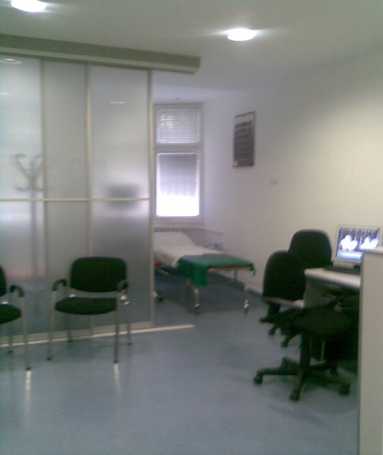
Introduction
The purpose of this study was to investigate the possibilities of TCD detection of MES in order to proof thromboembolism as one of stroke mechanism in APS.
The source of thromboembolism may be a thrombus in the artery of the neck or large arteries of the brain (artery to artery embolism), or cardioembolism in Libman Sacks endocarditis which often follows APS or the others cardioembolic lesions [Miyakis et al, 2006].

Slide 4
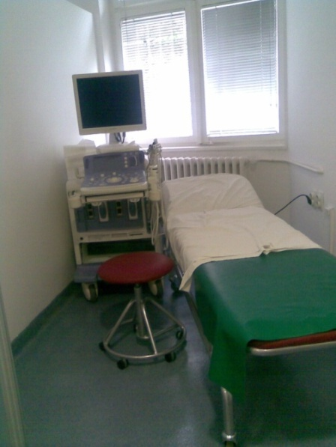
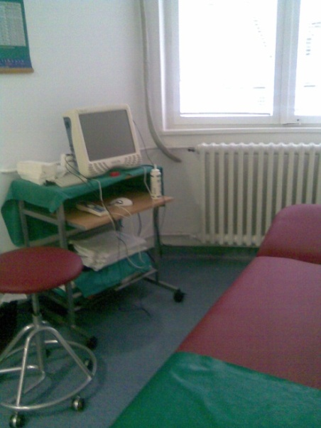
Introdaction
Thromboemboli, which are present in cerebral arteries, can be detected by transcranial Doppler (TCD) as microembolic signals (MES), also referred in the literature as HITS (high-intensity transient signals) [Edmonds et al. 2011].
The sources of thromboembolism can be registered by the other ultrasound methods, which will be named in methodology.

Slide 5
Materials and methods
Investigation group: 36 patients with APS and stroke (APS+stroke group)
hospitalized at the Neurology Clinic of the Clinical Center of Serbia (CCS) in Belgrade and Hematology Clinic of the CCS in Belgrade (Department of Coagulation Disorders)
from October 1, 2011, until October 1, 2016.
The inclusion criteria comprised adult patients (aged over 18) with confirmed APS and stroke. The exclusion criteria were: the presence of inflammation or malignant disease, pregnancy, and the use of drugs leading to the occurrence of aPL antibodies.
Control group (CG): APS-stroke, consisting of 26 patients with APS without stroke (matched by gender and age)

Slide 6
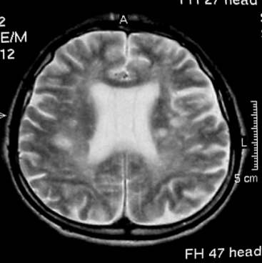
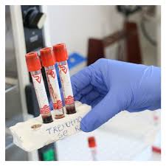
Materials and methods
Arterial stroke was confirmed by magnetic resonance imaging (MRI)
APS was identified according to the Sydney Consensus [Miyakis et al. 2006].
The lupus anticoagulant (LAC) and anti-cardiolipin (ACL) antibodies of the IgG and IgM class, along with anti-beta-2 glycoprotein I (anti-beta-2 GPI) antibodies of the IgG and IgM class, were analyzed.
The study was approved by the Expert Committee of the Neurology Clinic, CCS, the Ethics Committee of the CCS and the Ethics Committee of the Belgrade University Medical School. All participants gave an informative consent to participate in the study. The study was conducted in accordance to the Helsinki Declaration of the World Medical Association.

Slide 7
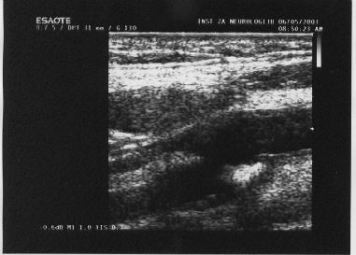
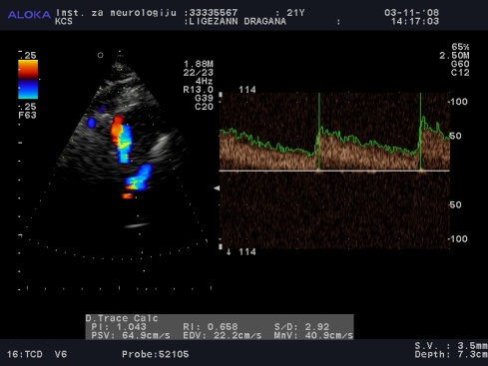
Materials and methods
TCD detection of MES was performed by a 30-minutes bilateral recording of the middle cerebral artery (MCA) within two weeks after the stroke [Edmonds et al. 2011] (Rimed DigiLiteᵀᴹ, Raanana, Israel, Holter probes LMY-2. 2 MHz probes).
Color Doppler examination of cervical segments of the carotid and vertebral arteries [Grant et al. 2003] with the Mannheim criteria for the assessment of atheromatous plaques [Touboul et al. 2012], (Aloka alpha-10, Hitachi, Tokyo, Japan, probe 7.5 to 14 MHz).
TCD color Doppler examination of cerebral arteries [Katz and Alexandrov 2003] (Aloka alpha-10, Hitachi, Tokyo, Japan, probe 2.0 MHz).
TCD detection of r-l cardiac or pulmonary shunt, bubble test [Spencer et al. 2004, Akhondi et al. 2010] (Rimed DigiLiteᵀᴹ, Raanana, Israel, probe holter LMY-2. 2 MHz probes).

Slide 8
Materials and methods
Transthoracic echocardiography (TTE) in all patients in both of the groups (Aloka alpha-10, Hitachi, Tokyo, Japan, tissue harmonics, 2MHz probe), and transesophageal echocardiography (TEE) in smaller number of patients, primarily on the basis of TTE and positive bubble test (Sequoia C256, Mountain View , California, multifrequency 2.5-4 MHz probe 3 V2C with "secondary tissue harmonics" technology) [Peterson et al. 2003]. The patients with paradoxical embolism were subjected to ultrasound examination of the extremity, pelvic, and abdominal veins [Gillespie, Glass 2010] (Aloka alpha-10, Hitachi, Tokyo, Japan, probe of 7.5 to 14 MHz).

Slide 9
Results
In the APS+stroke group the mean age was 39.5 ± 10.7 years, with 21- 58.3% females;
In the CG, the mean age was 35.6 ± 9.6 years, and 19 - 73.1% were females.
The patients mostly had primary APS - 86.1% and 84.6% in the APS+stroke group and CG, respectively.
The average duration of APS from the onset to the occurrence of stroke was 6.2 ± 5.9 years in the APS+stroke group.
The APS duration from the onset to the moment of examination was 4.07 ± 2.55 years in the CG.

Slide 10
Table 1. Elevated aPL antibody values in the APS+stroke group and CG
Type of aPL ab | APS+stroke aPLab-elevated levels n (%) | CG aPLab-elevated levels n (%) | significance
LAC | 21/36 (58.3 %) | 14/26 (53.8 %) | p=0.725
ACLab IgG | 20/36 (55.5 %) | 13/26 (50.0 %) | p=0.665
ACLab IgM | 18/36 (50.0 %) | 13/26 (50.0 %) | p=0.999
Anti-beta-2GPI ab IgG | 17/36 (47.2 %) | 13/26 (50.0 %) | p=0.829
Anti-beta-2GPI ab IgM | 16/36 (44.4 %) | 11/26 (42.3 %) | p=0.867
p>0.05

Slide 11
Tb. 1, commentary
There was no statistically significant difference in the representation of antibody types in the APS+stroke group compared to the CG (p>0.05).
The results of 10 patients - 27,7% showed elevated levels of all three types of antibodies, in 14 patients - 38,8% two antibody types were elevated, while 12 patients had elevated levels of only one antibody type.
66,5 % APS+stroke patients had elevated two or three types of aPL antibodies. In the CG, the number of patients with elevated level three or two type aPl ab was lower, but without statistical significance (p>0.05).

Slide 12
Table 2. Neuroradiological findings – MRI of the brain in APS+stroke patients
Neuroradiological findings (MRI of the brain) | n | %
Brain infarction | 6 | 16,7
Brain multiinfarctions | 18 | 50,0
Bain lacunar infarction (small vessels disease) | 4 | 11,1
Brain multilacunar infarctions (small vessels disease) | 8 | 22,2
Total | 36 | 100

Slide 13
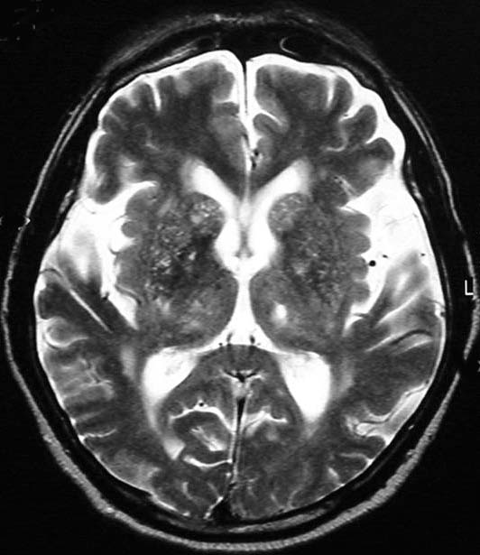
Table 2. Neuroradiological findings – MRI of the brain in AFS+stroke patients (commentary)
Brain ischemic lesions were mostly in the form of multiinfarction and multilacunar lesions (72.2%) and localized mostly in the anterior cerebral basin (63.9%).
Magnetic resonant angiography (MRA) showed a complete occlusion of the cerebral arteries in 15.6% patients in the APS+stroke group (ACA in two patients, MCA in one patient, VA in one patient, and the VA, CPA and partially BA in one patient).
Clinical manifestations of the patients of APS+stroke group correlated with localizations of infarction lesions.

Slide 14
Table 3. Results of ultrasound examination of patients with APS+stroke and CG
Type of ultrasound examination | APS+stroke N (%) | CG N (%) | significance
Intima-media thickness (intima-media, mm) FC plaq.stenosis of ICA ˂ 50% | 10/36 (27.8%) (0.88±0.19 mm) 10/36 (27.8%) | 4/26 (15.4%) (0.70±0.22 mm) 4/26 (15.4%) | p= 0.250 (p=0.001) p= 0.250
Occlusion of ICA | 1/36 (2.8%) | 0/26 (0%) | p=0.999
Unstable carotid plaque FC plaq.stenosis AV ˂ 50% | 2/36 (5.6%) 2/36 (5.6%) | 0/26 (0%) 1/26 (4.2%) | p=0.505 p=1.000
TCD-cerebral arteries occlusion | 5/32 (15.6%) | 0/21 (0%) | p= 0.057
TCD-stenosis of cerebral arteries ˂ 50% | 6/32 (18.8%) | 4/21 (21.1%) | p= 0.841
MES + | 2/25 (8.0%) | 0/15 (0%) | p= 0.519
Bubble test+cardiac type | 11/26 (42.3%) | 7/13 (53.8%) | p = 0.269
TTE/TEE – cardiac embolic lesions | 8/36 (22.2%) | 1/26 (3.8%) | p= 0.043

Slide 15
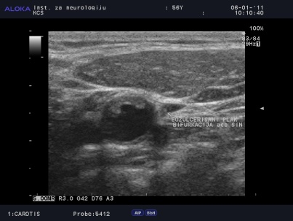
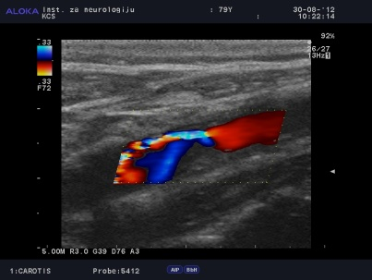
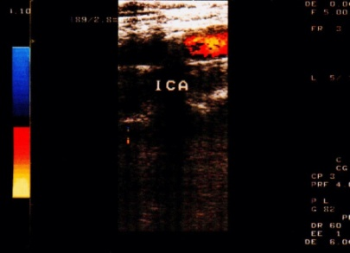
Table 3. Results of ultrasound examination of patients with APS+stroke and CG (commentary)
There was no statistically significant difference in the frequency of IM thickness, but the degree of IM thickness was statistically significantly higher in the APS+stroke group compared to CG.
There was no statistically significant difference in the presence of fibrocalcified plaques in the carotid, vertebral and cerebral arteries between the examined groups, including unstable plaques in the carotid arteries.
A marginally significant higher frequency of cerebral artery occlusions was found in the APS+stroke group compared to CG.
MES was detected in 8% of patients in the APS+stroke group without statistically significant difference in relation to CG.
There was no statistically significant difference in the degree of presence of r-l shunt between the examined groups.

Slide 16
Table 3. Results of ultrasound examination of patients with APS+stroke and CG (commentary)
It has been confirmed that 8 –22.2 % patients in the APS+stroke group had pathological cardiac lesions with embolic potential.
In the CG, one patient had cardiac lesion with embolic potential- PFO with a minimal, non-significant r-l shunt.
Pathological heart conditions with embolic potential were more frequently observed in the APS+stroke group compared to the CG and this result reached statistical significance (p = 0.043, p<0.05).
Two of those patients had a thrombus in the left auricle, four patients had patent foramen ovale (PFO), one patient had Libman Sacks endocarditis and one had mitral valve prolapse (MVP).

Slide 17
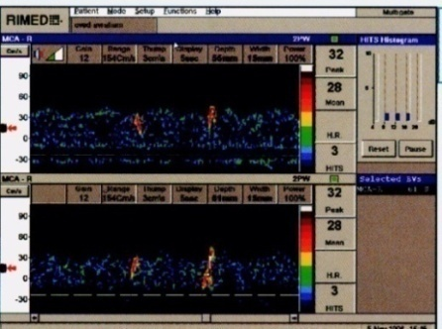
Table 3. Results of ultrasound examination of patients with APS+stroke and CG
MES were detected in the cerebral arteries of two patients from the APS+stroke group only (8.0%).
The first patient had bilateral MES and he had a thrombus in the left auricle (cardiac embolism). The second patient had unilateral MES and ipsilateral unstable plaque with appositional thrombus resulting in 45% stenosis of the ICA (artery to artery embolism).
MES were not registered in any patient in the CG.
There was no statistically significant difference between the investigated groups (p>0.05).

Slide 18
Table 3. Results of ultrasound examination of patients with APS+stroke and CG
22,2% patients with cardiac embolic lesions and 5,6% patients with unstable, exulcerated plaques of ICA, together it was 27,8% patients with thromboembolic potential, but MES were detected in 8% patients, only .
In the others patients MES were not detected during the 30-minutes detection period. But, it did not exclude them. For more reliable results, long-term monitoring with inclusion of BA is necessary [Yamaoka et al. 2014].
Also, examination should be carried out on the first day after stroke, when the number of emboli is highest and the effects of antiplatelet therapy can be avoided.

Slide 19
Table 3. Results of ultrasound examination of patients with APS+stroke and CG
In the group of patients with positive cardiac type bubble test, TEE confirmed the existence of r-l shunt in 4 PFO cases (4/26, 15.4%). The bubble test is not reliable for assessing of r-l shunt and can only be a screening test. TTE/TEE was necessary to definitely confirm the existence of r-l shunt.
In the CG group, there was only one patient with TTE conirmed r-l shunt (PFO).
Ultrasound examination of the peripheral veins did not show current peripheral venous thrombosis in any of the patients included in the study, thus there was no potential source of paradoxical embolism.

Slide 20
Conclusion
By complex ultrasound investigations, we detected statistical significantly the most often cardioembolic lesisons in the group with APS and stroke than in APS group without stroke;
then, more often occlusion of cerebral arteries and
greather intimo-medial thickness than in group APS without stroke.
During 30-minutes, MES were detected in a small, nonsignificant number of patients with APS and stroke. We beleieve that methodological reasons are in the question. More reliable results would be obtained using long-term MES detection, of all cerebral arteries, on the first day of stroke.

